Slide 1
CS 295B/CS 395B Systems for Knowledge Discovery
Lecture 4: Formal Language Design as Method

Slide 2
Topics
Papers: context
Databases vs. IR
Concurrency vs. parallelism
From SIMD to MapReduce
Execution plan

Slide 3
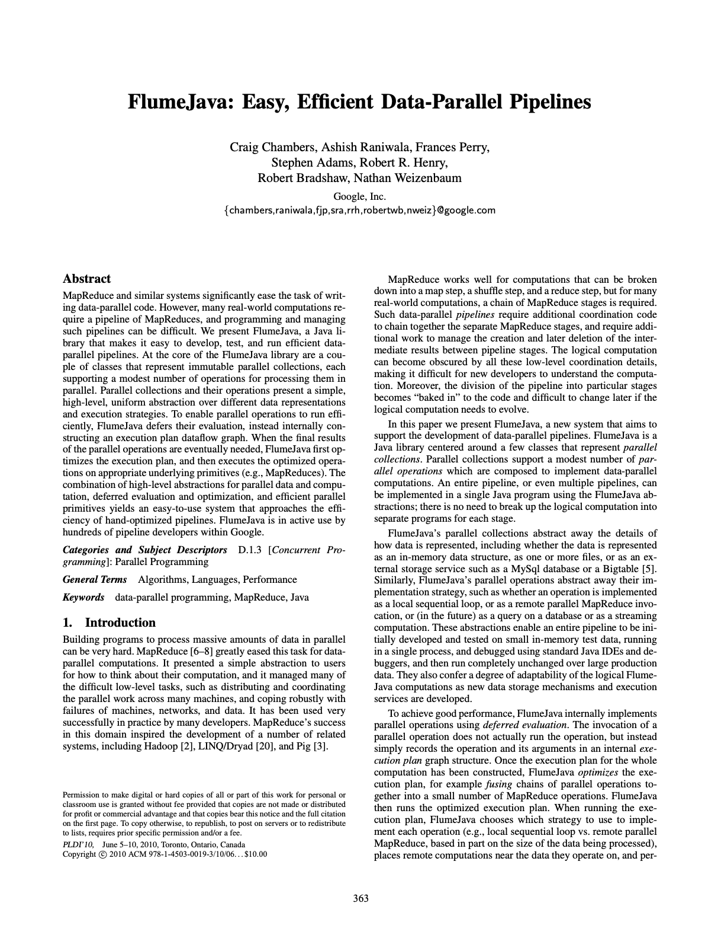
Paper background
Complement paper to Spark SQL
Why Spark SQL + CaRL pairing?
Notes:
Spark SQL + CaRL = modern concerns in query languages

Slide 4
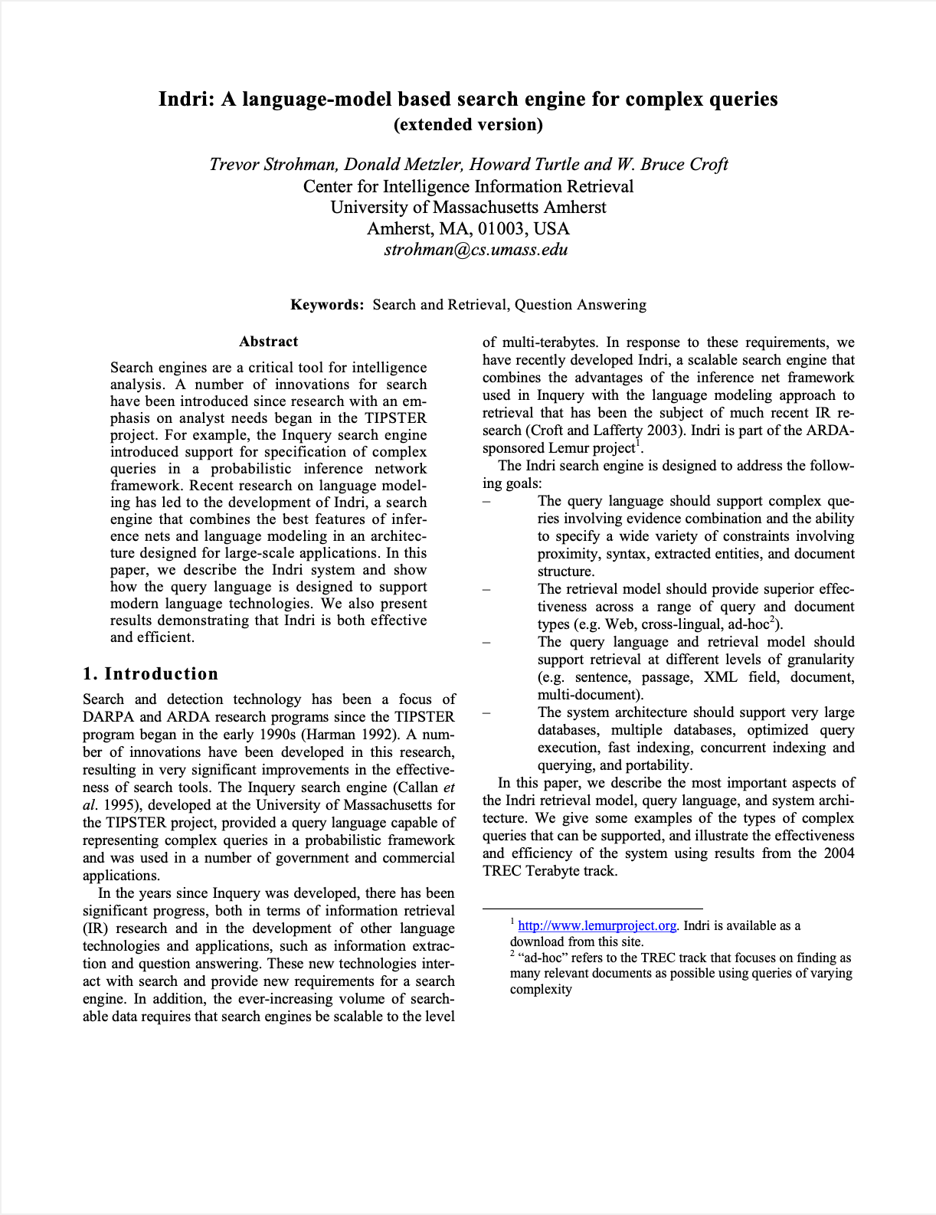
Paper background

